Slide 1
Multifaceted Linked Imagery
Bringing Together Pictoral Regions with Matthew Davis

Slide 2
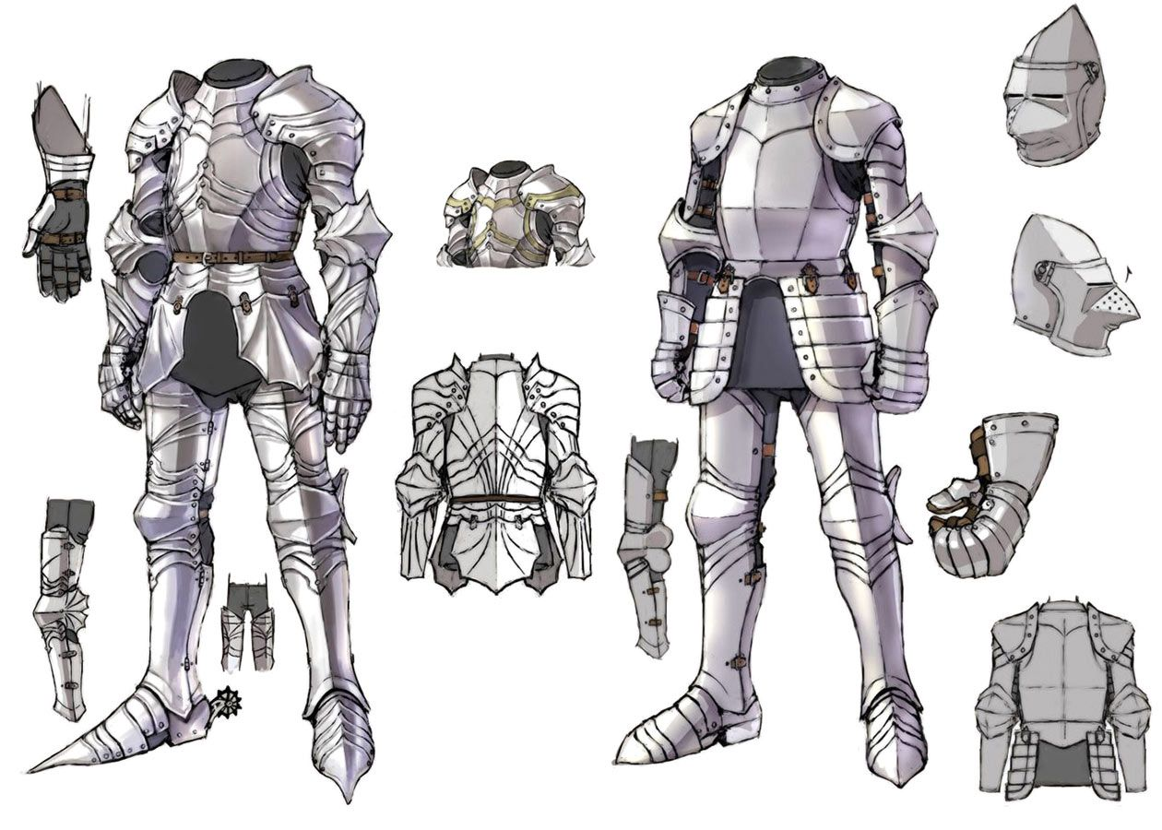
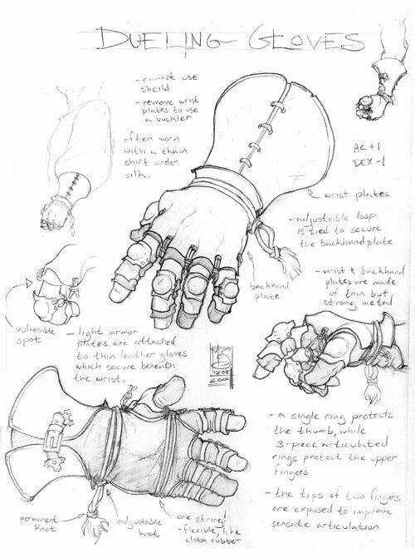
Image Cross Referencing
Notes:
Introduction, High level description
The problem I am seeking to solve here is a problem of image interconnection, or as the slide states, the cross referencing of images. Here we can see two rather similar images, or at least images that we can see are similar. Across these images I have drawn regions pertaining to the gauntlets each image displays. Now, these gloves could have many different names or labels (which we shall call facets). Suppose we want to connect these images based strictly off of the labels that we apply to these regions, or that in the first image we wish to draw many more regions for each part of the armor, and link those to other images containing references to those parts, patterns, or designs. This is the problem I wish to solve.
An application that allows a user to manipulate regions upon images, label them, and hyperlink them together such that they can use a single region to bring up every image connected to image, and then dig further to bring up images connected to the regions of the first connected images. Creating a web of connected images that can be brought together with a single search.

Slide 3
References and Aids
R. Singh, C. Massa and P. -. Corlobe, "Multifaceted Hyperimage-Based Organization and Interaction with Bio-Medical Images," Twentieth IEEE International Symposium on Computer-Based Medical Systems (CBMS'07), Maribor, 2007, pp. 153-158, doi: 10.1109/CBMS.2007.74.
Singh, R, Nakata, R, and Downs, J. "Characterization and Analysis of Emergent Image Semantics Using Network Models." (2011): 411-18. Web.
Notes:
Prior work. Mention Father for Django set up and data characterization, audio discussions with friends and family for ui structure and design.

Slide 4
Framework
And
UI
Django
DRF
Axios
React
React Redux
Material UI
Notes:
High Level Description, Previous work
For my application, I am using Django with the Django Rest Framework atop it to manage and connect the serverside information holding and connections. Here, Images, Regions, and Facets are stored. Images and Facets are connected by using Regions as a through table, and the front to back searching offered by DRF allows for relatively easy and fast connections for bringing together searches.
Axios is used as the connection bringing together the backend and the front end.
React and Material UI are the main bricks of the front end, with React being the base and Material UI offering many foundational components to help with animating and creating a user friendly environment. React Redux is a React port for the Redux store system, which uses a central store to keep states of the different components in the application. Overall, React Redux is to make encapsulating components easier while still making them able to interact and modify the states of one another, such as handling what the current image being worked on is.

Slide 5
App Architecture
React Redux
DRF
React
Images
Axios
Image View
Image
Scroll
Regions
Search
View
Facets
Notes:
Overall, this is the block architecture of my application, with DRF encapsulating the backend, React Redux provide the primary store for the React app, and Axios working as the inbetween for the two. Image Scroll, Image View, and Search View are the three primary components of interaction. The Image Scroll holds a list of all images uploaded by a user, and acts as image selector for a user to work on. The Image View displays that image, where the image can have regions selected and drawn on. The Search View then takes the currently selected image and region, and displays a tree structure of all images connected through this manner.

Slide 6
UI Design
View Pane
Tree Pane
Nav
Bar
Image Scroll
Notes:
Simplified UI design for the block design.

Slide 7
Future
Experiments
Location of Set Data: ImgFile or Regions
Image ratio
Single or multiple facets to a region
Image search algorithm and set manipulations
Potential changes to
design architecture
Notes:
As will be touched on later, I have not done any experiments yet, however I have many points and concerns regarding efficiency and user interaction. I want to look at where is most effecient to locate the set data for hyperlinks, whether it should be connected to the image or to the region. I am tinkering with how to display images and whether they should be scaled to fit the window, at 100% ratio but scrollable, or have that be selectable. I am also tinkering with the connection between regions and facets, and whether that connection should be many to one, or many to many. Finally, I have a couple of ideas pertaining how to actually collect connected images and how to display them, which will require a fair amount of headway before I can start tinkering with that process.

Slide 8
Prototype
Coming Soon
Notes:
Sadly, I don’t have a working prototype or even much of one to show. I have configured the data models and connections for the backend, and as far as that side is concerned, images can be uploaded, have regions drawn on them, have labels applied to the regions, and have groupings made based off of these regions. However, the biggest crux of this is the front end, which while I have a formulated plan to tackle, is sadly not yet in a functional state.

